Slide 1
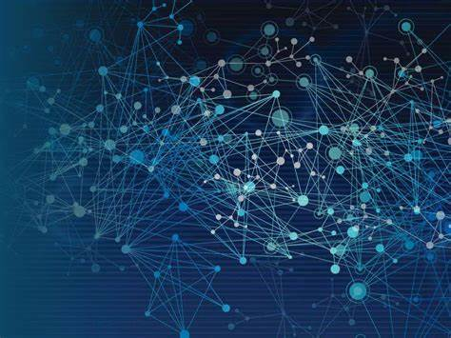
What Is Information Technology?
A Beginner’s Guide to the World of IT
For many people, information technology (IT) is basically synonymous with the people you call when you need help with a computer issue. While that view of information technology isn't totally wrong, it drastically understates the scope of this critical career field.
If you're looking to get a better handle on what information technology is - and the many facets of this field - then you've come to the right place.

Slide 2
What is information Technology and what does it encompass?
The most basic information technology definition is that it's the application of technology to solve business or organizational problems on a broad scale.
No matter their specific IT role, members of an IT department work with others to solve technology problems, both big and small. Information technology plays such a vital role in today's wireless world.
To enhance operational efficiency, many global companies compete for a workforce with salient technical skills and often hire network administration professionals, network monitoring staff, user support technicians, network architects, other architecture experts and many other individuals.
You might already know that an IT department serves to ensure that the computer network, computer hardware, computing devices, and other physical devices all

Slide 3
IT governance: This refers to the combination of policies and processes that ensure IT systems are effectively run and in alignment with the organization's needs.
IT operations: This is a catchall category for the daily work of an IT department. This includes providing tech support, network maintenance, communication protocols, security testing and device management duties.
Hardware and software infrastructure: This focus area refers to all the physical components of IT infrastructure. This pillar of IT includes the setup and maintenance of equipment like routers, servers, phone systems and inventory control - including individual devices like laptops.
IT departments also help to automate the business environment and create processes for many of their respective company's daily tasks, so that the business continues to run smoothly.
The ideal IT department is also aligned with the business's goals. Additionally, the department should always be transparent in its processes - providing valuable insights in a way that the rest of the business can understand and provide input on.

Slide 4
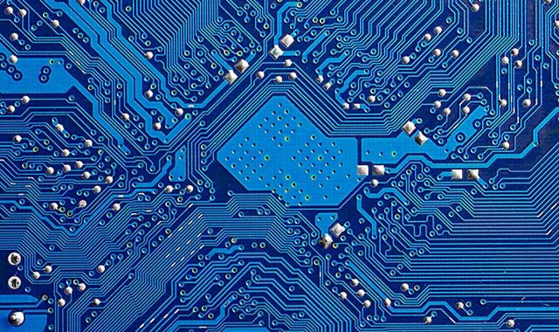
What is the Difference between Hardware and Software
What is the Difference between Hardware and Software
Hardware
Software
\
Hardware includes all the physical parts of a computer system. This includes hardware installed inside the computer like the motherboard, central processing unit and hard drive.
Software is not something you can physically change. Software encompasses all the data, application and programs stored electronically, like an operating system or a video-editing tool.

Slide 5
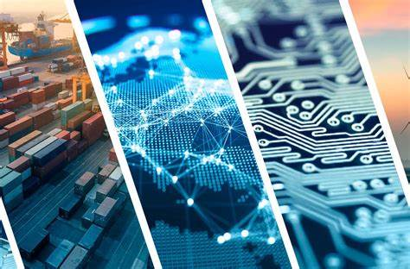
Why is information technology so important?

Slide 6
Data overload issues:
Businesses need to process huge amounts of data. This requires large amounts of data processing and power, sophisticated software and human analytical skills.
Mobile and wireless usages:
More employers are offering remote work options that require smartphones, tablets and laptops with wireless hotspots and roaming ability.
Cloud computing services:
Most businesses no longer operate their own “server farms” to store massive amounts of data. Many businesses now work with cloud services—third-party hosting platforms that maintain that data.
Video hosting and bandwidth issues:
Videoconferencing solutions have become more and more popular, so more network bandwidth is needed to support them sufficiently.
AI and machine learning:
Artificial intelligence (AI) and machine learning allow businesses to automate, scale up and use complicated models to anticipate everything from market changes to weather patterns. With the massive volume of data these days, AI is quickly becoming a mainstay in the business world.
Cybersecurity:
Cybersecurity is all about securing computer systems all about securing computer systems, networks and data. As businesses depend on their digital systems to function, cyber-attacks that threaten to delete or stall those functions can get pose a massive threat. Theft of private data is also a huge concern, requiring dedicated cybersecurity measures to consistently repel thieves.

